Slide 1

CSE 6363 MACHINE LEARNING
REAL-TIME SOCIAL DISTANCING DETECTION USING YOLO ALGORITHM

Slide 2

Team Members
Akhila Kolapalli – 1001977119
Sai Surya Sasank Nekkanti –1001980440
Lakshmi Poojitha Pericharla - 1001915084

Slide 3
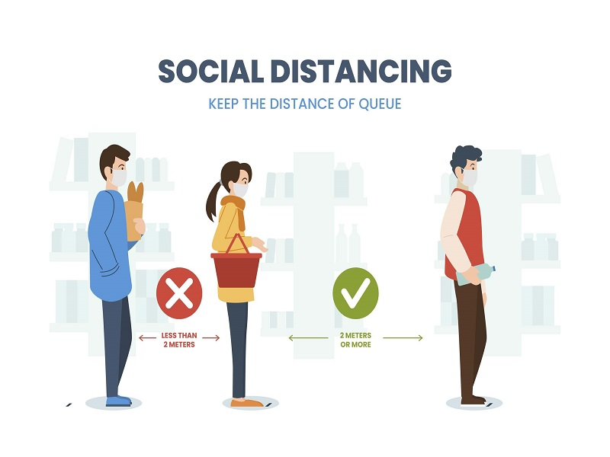
Introduction
YOLO stands for You Only Look Once, this algorithm is used for Object Detection as well as Object Tracking, this research uses YOLO for calculating the social distancing with the help of Object Detection, the model was trained and used for object detection as well as object tracking.
There are different types of algorithms available, YOLO stands out from all the other present currently.
The calculations are done by measuring the centroid distance between the pedestrians, this will represent whether the pedestrians in the video follow sufficient social distance

Slide 4
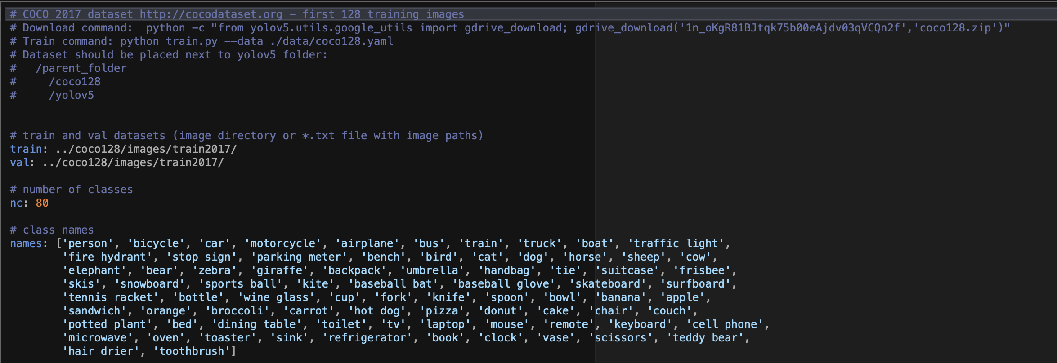
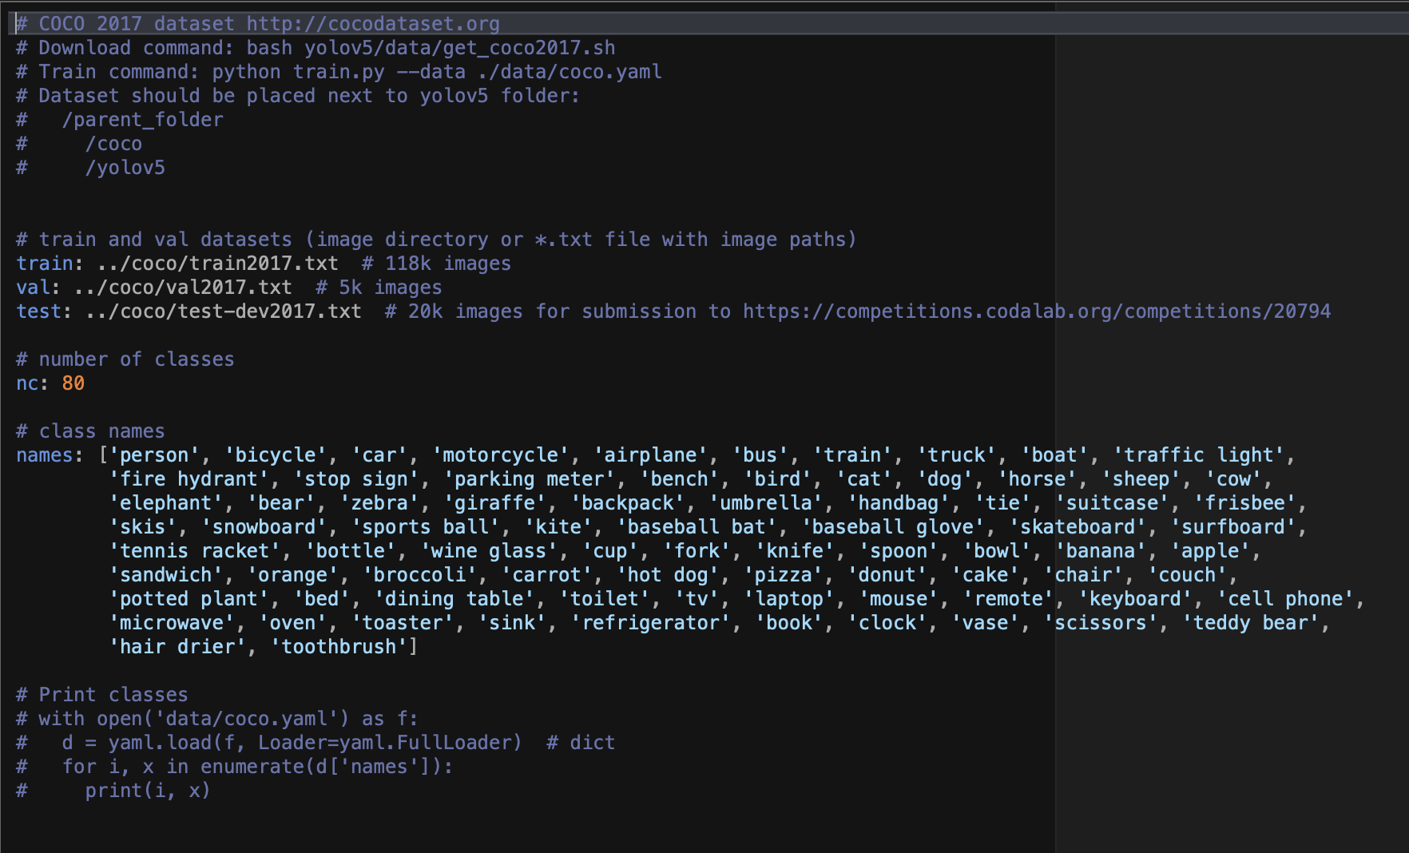
Dataset Information
Coco128.yaml
The COCO (Common Objects in Context )data-set is used in our project, which is a large –scale object detection dataset published by Microsoft.
The COCO dataset contains challenging, high-quality visual datasets for computer vision, mostly state-of-the-art neural networks.
The format of the COCO dataset is automatically interpreted by advanced libraries.
We downloaded the dataset from this link: Coco Dataset and Coco128 Dataset
Coco.yaml contains 118k train Images with certain classes shown in picture.
Coco128.yaml contain 128 Images with certain classes shown in picture.
Coco.yaml

Slide 5
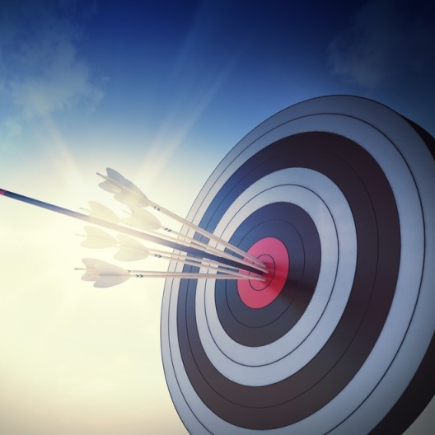
Aim:
Our aim is to predict the class of an object, bounding box specifying the height and width of the object, X and Y coordinates are obtained by calculating the center of the x and y .
Each annotation data is trained as : (<object class> <x_coordinate> <y_coordinate> <width> <height>).
Idea behind this project was Coronavirus had a great impact on various sectors of the world that be Industrial or Transportation or Agriculture, this impact caused the world to stop every sector and ordered to follow strict restrictions for following social distancing & wearing a face mask on a priority basis.

Slide 6
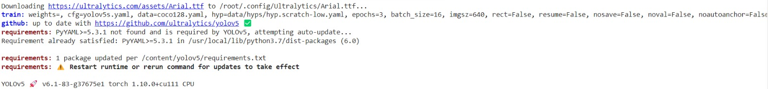
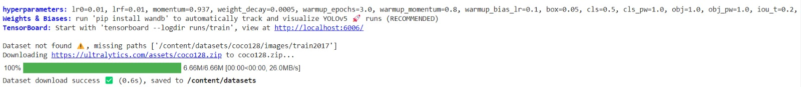
Downloading the Dataset

Slide 7
Hyperparameters are the variables which determines the network structure(Eg: Number of Hidden Units) and the variables which determine how the network is trained(Eg: Learning Rate)
While weights enable an artificial neural network to adjust the strength of connections between neurons, bias can be used to adjust within neurons.
TensorBoard is a tool for providing the measurements and visualizations needed during the machine learning workflow.

Slide 8
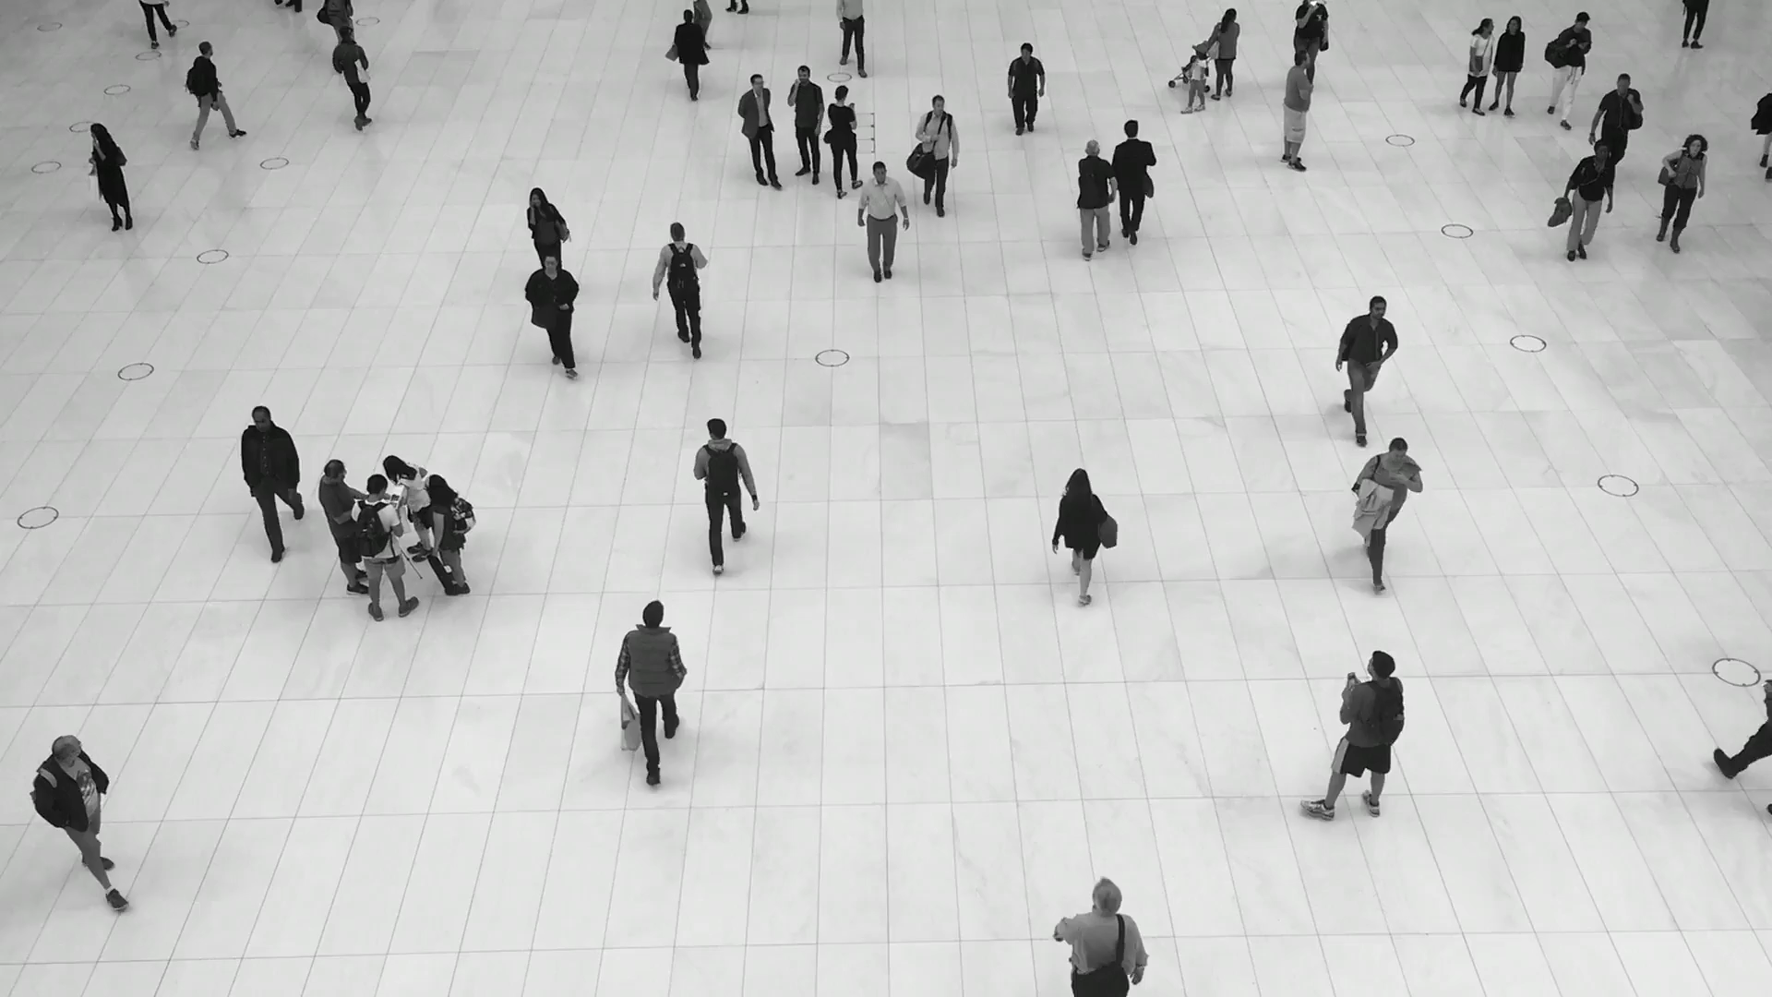
Input for Model

Slide 9
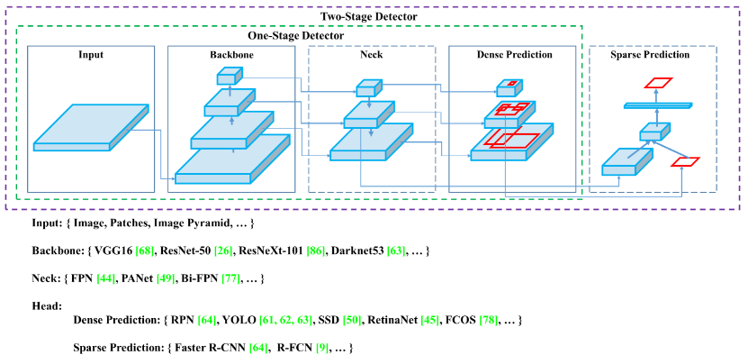
yolov5 Network structure

Slide 10
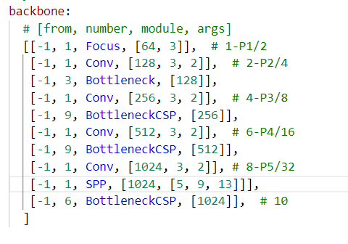
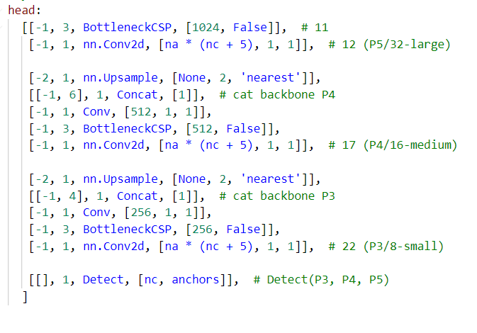
YOLOv5 Architecture:

Slide 11
Backbone Layer :
In YOLO v5 the CSP — Cross Stage Partial Networks are used as a backbone to extract rich in informative features from an input image. CSPNet has shown significant improvement in processing time with deeper networks.
Neck Layer:
Neck Layer is mainly used to generate feature pyramids. Feature pyramids help models to generalized well on object scaling. It helps to identify the same object with different sizes and scales. In YOLO v5 PANet is used for as neck to get feature pyramids.
Head Layer:
The Head Layer is mainly used to perform the final detection part. It applied anchor boxes on features and generates final output vectors with class probabilities, objectness scores, and bounding boxes.

Slide 12
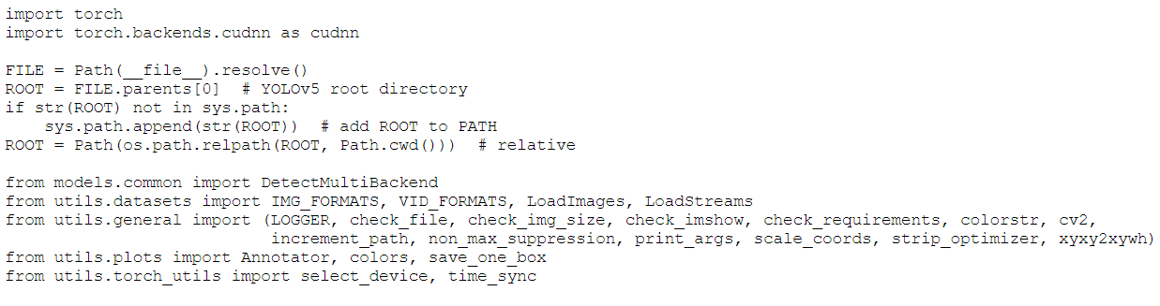
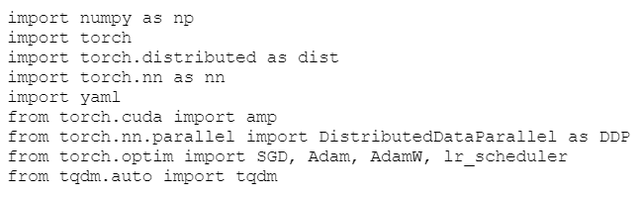
Libraries Used:

Slide 13
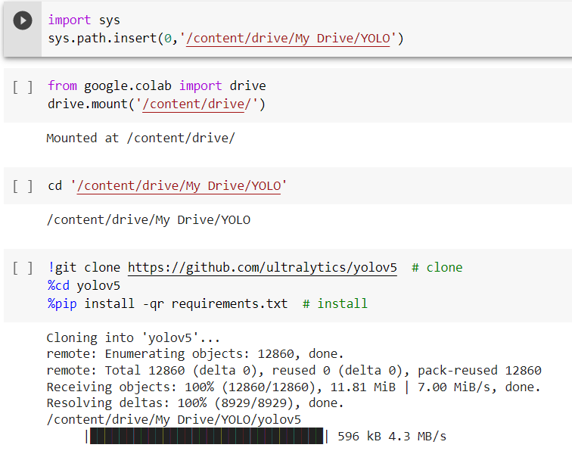
Training the Model

Slide 14
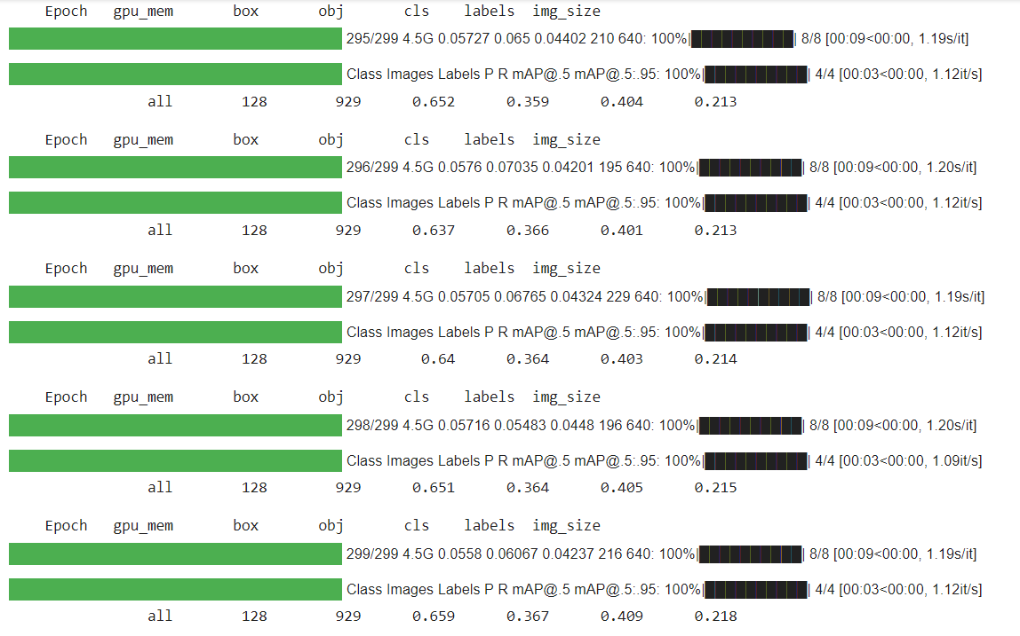
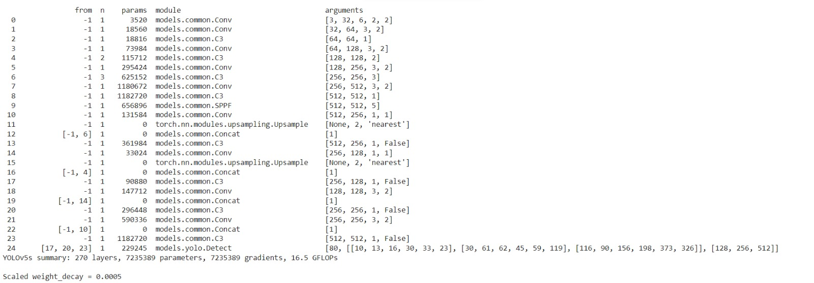
We have train model till 300 epoch.
And you can see that in summary classes and Images are loaded.

Slide 15
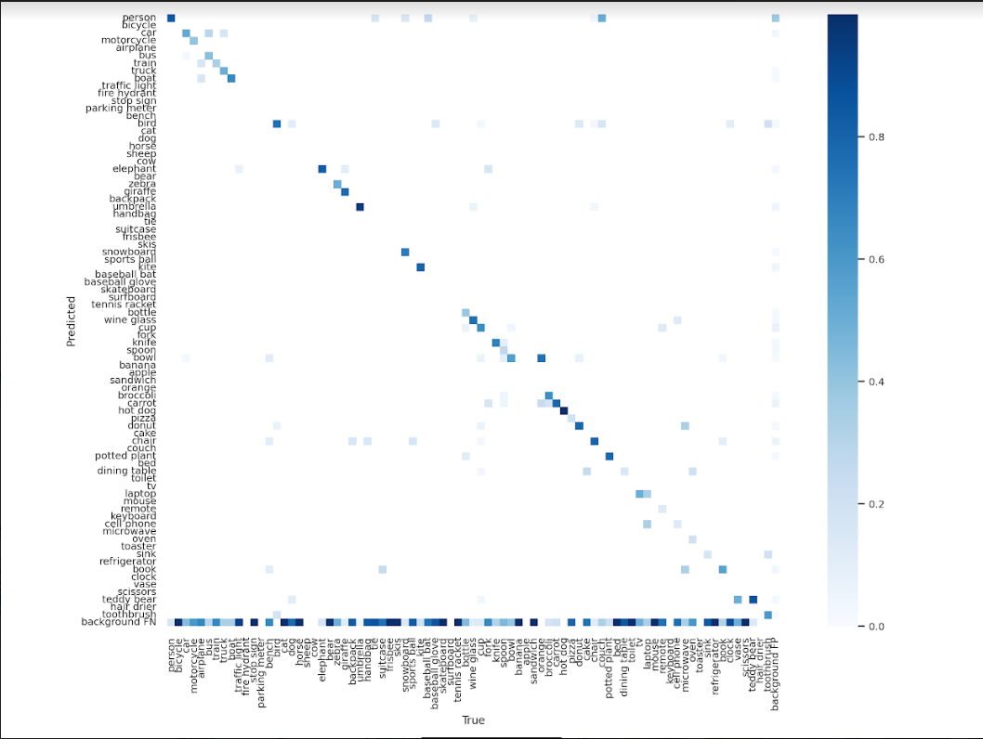
Confusion Matrix

Slide 16
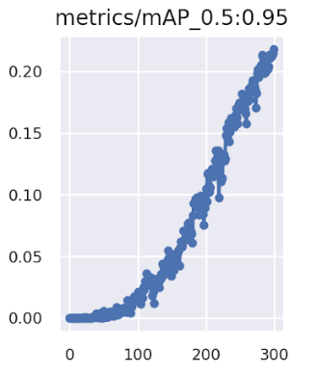
Accuracy

Slide 17
Detection and Prediction
Note:- use the weights from the trained model or it will take default weights/yolov5s.pt
Source:- Path where video is store and will taken as Input.
Weights:- After Training the data weight will be stored in this Path.

Slide 18
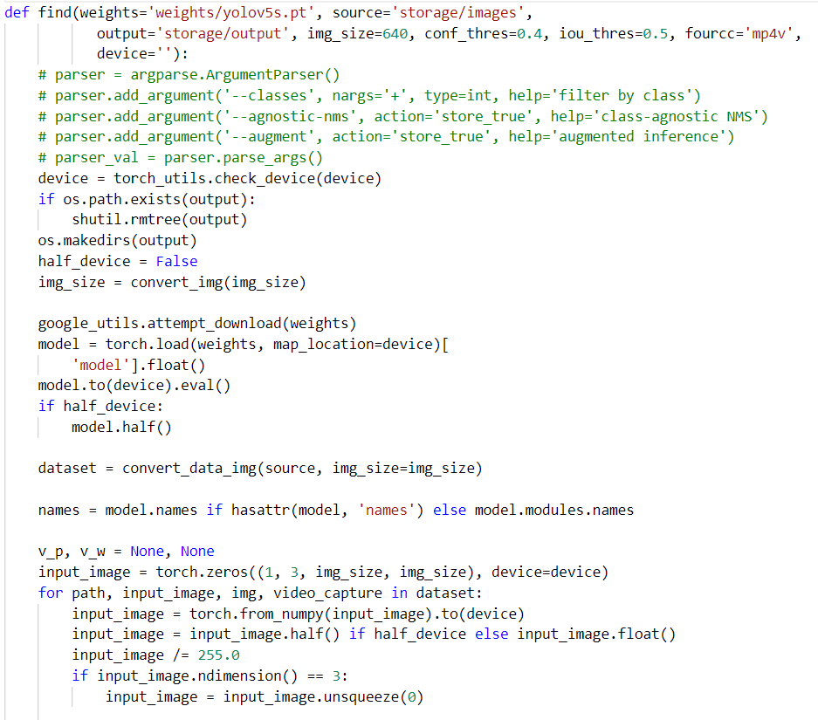
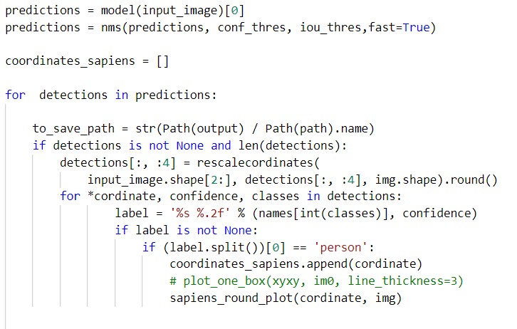
Implementation
Find Function

Slide 19
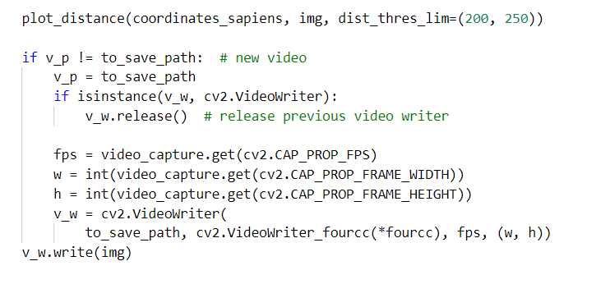
PLOT_DISTANCE
In mathematics, the Euclidean distance between two points in Euclidean space is the length of a line segment between the two points.

Slide 20
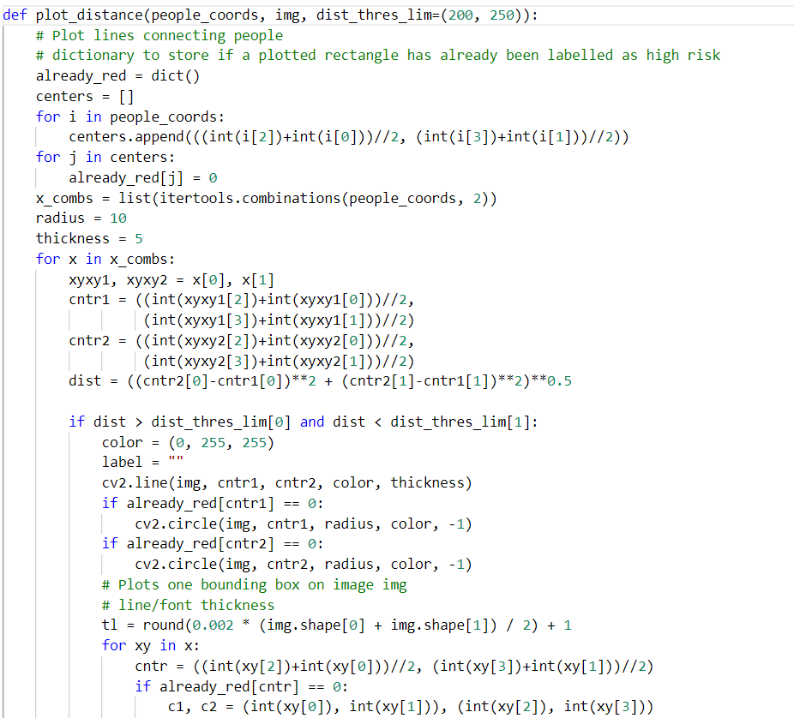
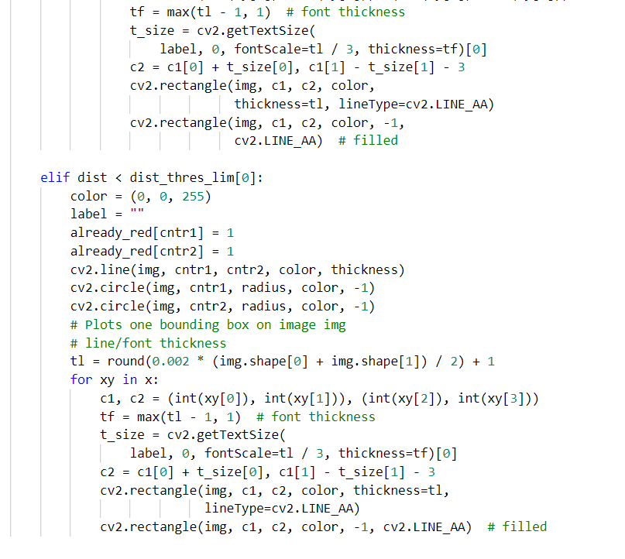
We have Define the plot_distance function and taken people co-ordinate and image.
In pictorial we have shown how the distance has been calculated.
Also, we have given condition that what distance should be there between two people so that it will show high risk or low risk

Slide 21
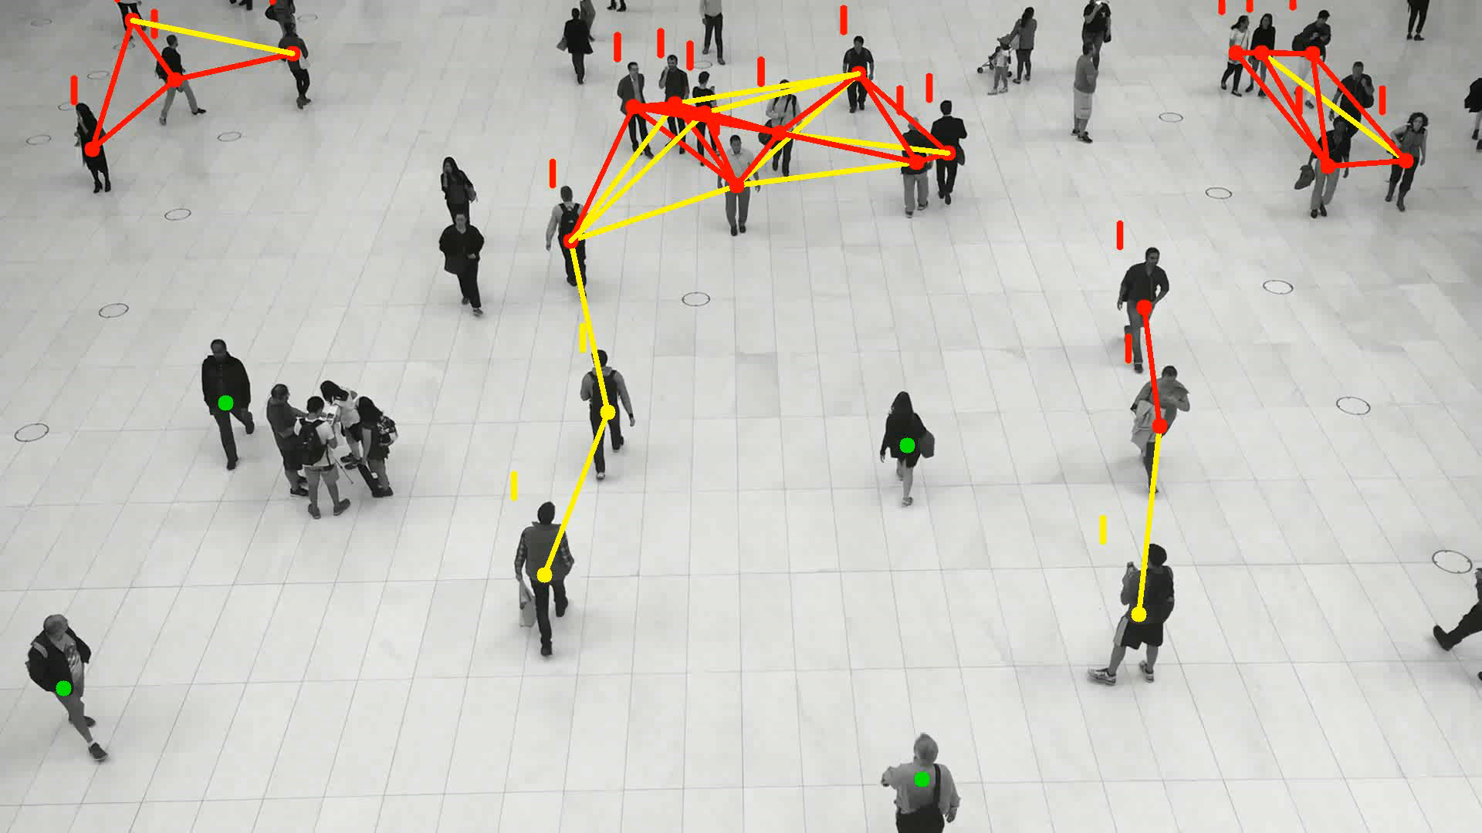
Output-

Slide 22
References:-
https://github.com/ultralytics/yolov5/blob/master/utils/activations.py
https://colab.research.google.com/github/ultralytics/yolov5/blob/master/tutorial.ipynb
https://docs.ultralytics.com
https://towardsdatascience.com/the-practical-guide-for-object-detection-with-yolov5-algorithm-74c04aac4843
https://towardsdatascience.com/how-to-create-an-end-to-end-object-detector-using-yolov5-35fbb1a02810

Slide 23

Thank You

